Slide 1
TEAM : Assistant
팀장
INC-CAPSTONE DESIGN1
Developing Motivation Application
● Computer Engineering 구명회
○ Computer Engineering 김경수
5
○ Computer Engineering 김선비
○ Computer Engineering 박효정
○ Computer Engineering 장자욱

Slide 2


CONTENT
INC-CAPSTONE DESIGN1 DEVELOPING MOTIVATION APPLICATION
● OUTLINE
1
○ DEBATE
○ DESIGN
○ REFERENCE
off
○ NEXT WEEK

Slide 3
OUTLINE
BACKGROUND>PURPOSE>EXPECT>TEAM
BACKGROUND
Sometimes you may have found effective study methods.
But their methods of learning vary, so their methods are not necessarily effective.
Therefore, the goal of project is to find the right learning method according to the formalized type.
This project will help those who are willing to learn by helping them to find a learning method
that is suitable for them and making learning more efficient and motivating them to learn.
2
off

Slide 4
OUTLINE
BACKGROUND>PURPOSE>EXPECT>TEAM
PURPOSE
Ask the user to collect data through a survey.
Analyze the type based on the user's gender, age, academic background, sleep time, and learning time,
and present efficient learning methods according to the type.
After a period of time, ask the user again for a survey to determine the values that have changed.
If any of the values have changed, modify them to fit users type, and then proposal a new method of learning.
3
off

Slide 5
OUTLINE
BACKGROUND>PURPOSE>EXPECT>TEAM
EXPECT
1. Create a group of family, friends to help develop themselves.
2. The goal is to improve the grades of learning, homework and exercise.
3. Find an efficient way to learn to be interested in your studies.
4. Provide rewards for mission success to gain motivation and fulfillment.
4
off

Slide 6
OUTLINE
BACKGROUND>PURPOSE>EXPECT>TEAM
TEAM
5
Name | Student id | E-Mail | Duty
 |  |  | Main | Sub
김경수 | 20124619 | studioarena24@gmail.com | Application design Application implement | Database design Database implement
김선비 | 20175160 | rlatjsql12@gmail.com | Analyze learning materials learning algorithm Implement | Web server design Web server implement
구명회 | 20154215 | 20154215@chosun.kr | Database design Database implement | Analyze learning materials learning algorithm Implement
박효정 | 20174302 | haha115500@gmail.com | Application design Application implement | Analyze learning materials learning algorithm Implement
장자욱 | 20174619 | 615060696@qq.com | Web server design Web server implement | Database design Database implement
off

Slide 7
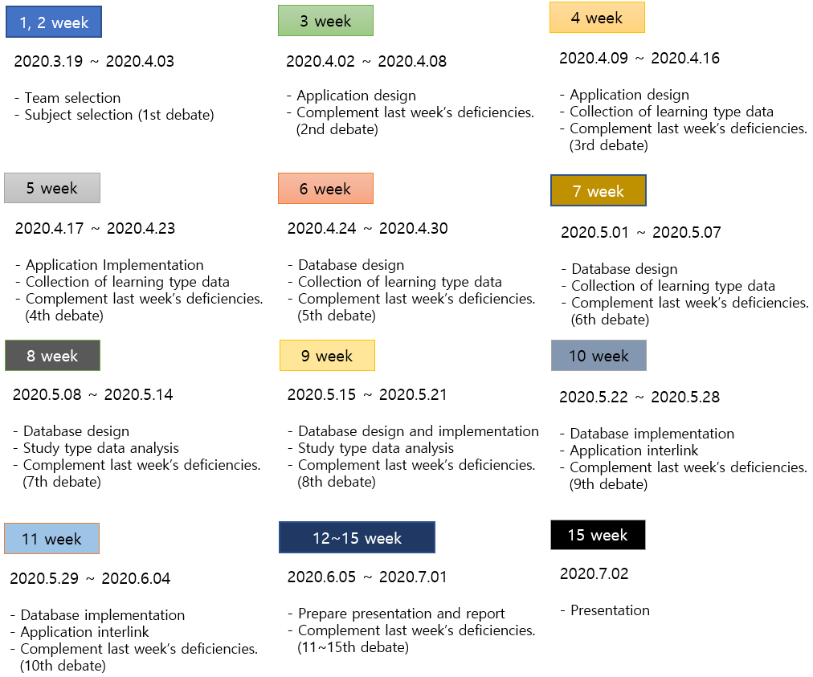
DEBATE
SCHEDULE>TOPIC>TOPIC DETAIL>ENVIRNMENT
SCHEDULE
6
off

Slide 8

DEBATE
SCHEDULE>TOPIC>TOPIC DETAIL>ENVIRNMENT
TOPIC
Developing Motivation Application
Team name : Assistant
7
off

Slide 9
DEBATE
SCHEDULE>TOPIC>TOPIC DETAIL>ENVIRONMENT
TOPIC DETAIL
1. Learning method
Produce a questionnaire based on recent study type tests.
Collect data from the questionnaire you create and categorize your type.
2. Additional idea
① Increase the variety of learning methods.
② Consider that learning methods are not limited to studying, such as exercise, singing, food, and games.
③ Then why don't we recommend an efficient exercise method or a random song?
④ Setting Categorize types By criteria, random recommend songs that are similar type
3. Application design(2020.3.30)
8
off

Slide 10
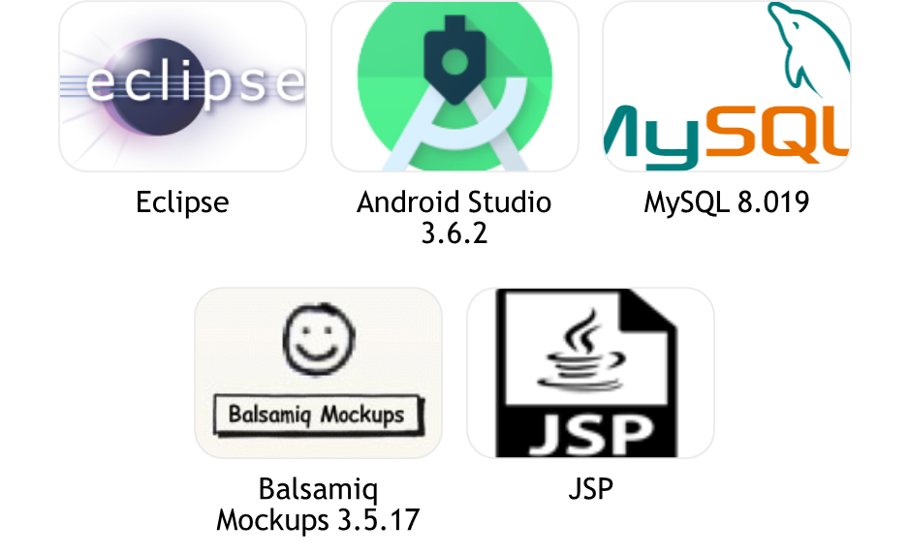
DEBATE
SCHEDULE>TOPIC>TOPIC DETAILS>ENVIRONMENT
ENVIRONMENT
9
off

Slide 11
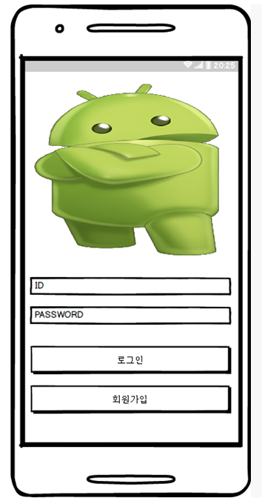
DESIGN
LOGIN>SIGN UP>MAIN>SURVEY>CHALLENGE>CHAT
LOGIN SCREEN
ID, PW INPUT
LOGIN BUTTON
SIGN UP BUTTON
10
off

Slide 12
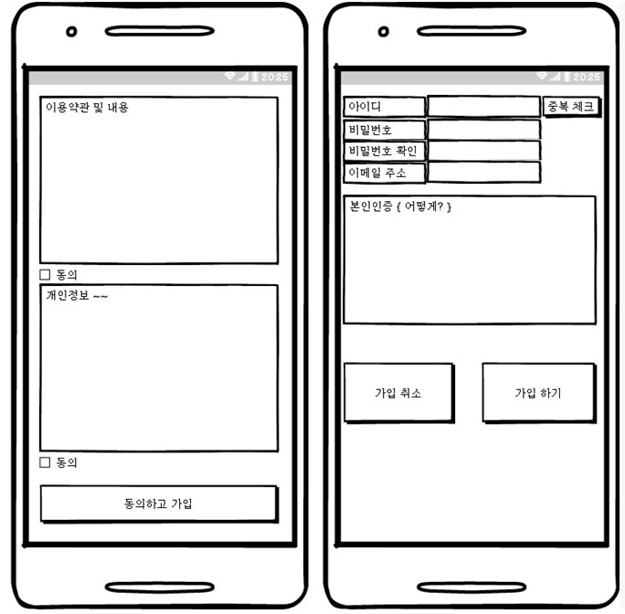
DESIGN
LOGIN>SIGN UP>MAIN>SURVEY>CHALLENGE>CHAT
SIGN UP SCREEN
Agree to use personal information
Input bar for create user account
Accept / Cancel button
11
off

Slide 13
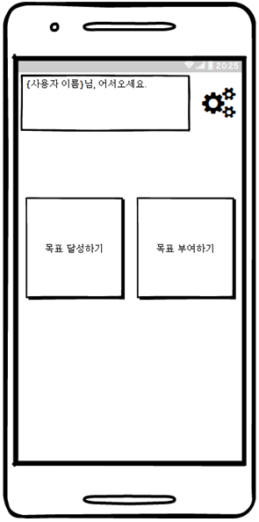
DESIGN
LOGIN>SIGN UP>MAIN>SURVEY>CHALLENGE>CHAT
MAIN SCREEN 1
Print user information
Setting button
Challenge Button
12
off

Slide 14
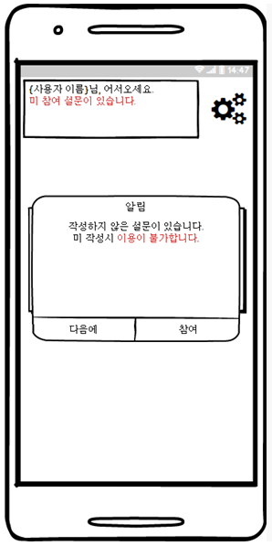
DESIGN
LOGIN>SIGN UP>MAIN>SURVEY>CHALLENGE>CHAT
MAIN SCREEN 2
Notify user of surveys that has not been performed
Survey Accept/Cancel button
13
off

Slide 15
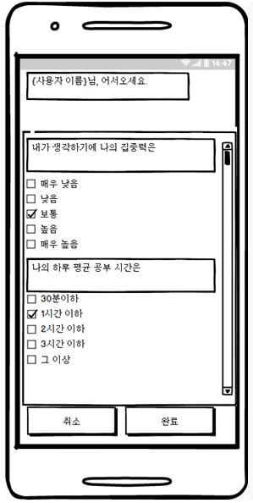
DESIGN
LOGIN>SIGN UP>MAIN>SURVEY>CHALLENGE>CHAT
SURVEY
Survey question bar
Four Multiple-choice check box
Accept / Cancel button
14
off

Slide 16
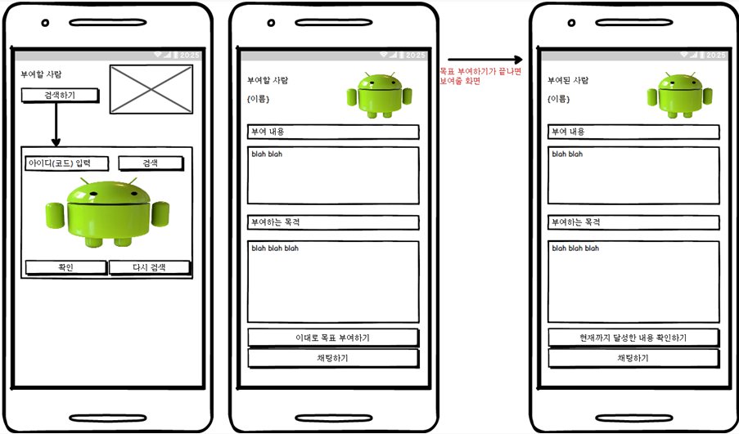
DESIGN
LOGIN>SIGN UP>MAIN>SURVEY>CHALLENGE>CHAT
CHALLENGE SCREEN
Print users information
Search / Chat button
Input bar for Name / Purpose information
Challenge Accept button
15
off

Slide 17
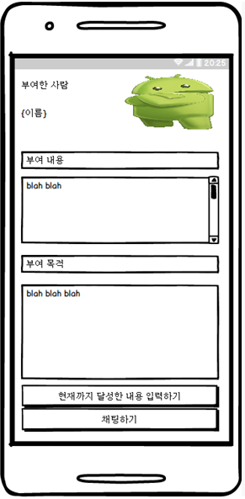
DESIGN
LOGIN>SIGN UP>MAIN>SURVEY>CHALLENGE>CHAT
CHALLENGE SCREEN
Print user information
Print Content / Purpose information
Input / Chat button
16
off

Slide 18
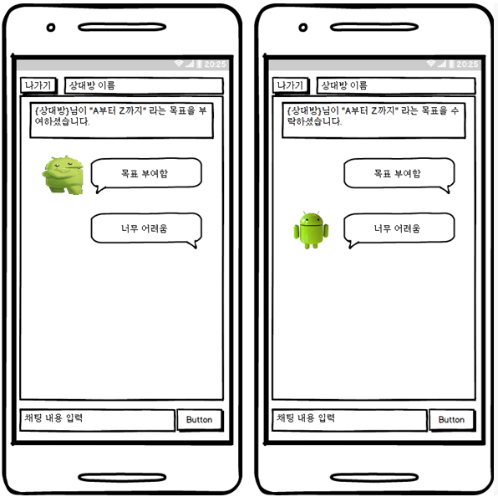
DESIGN
LOGIN>SIGN UP>MAIN>SURVEY>CHALLENGE>CHAT
CHAT SCREEN
Print user information
Challenge state
Chat input / print
EXIT BUTTON
17
off

Slide 19
REFERENCE
REFERENCE SITE
1. https://web.yonsei.ac.kr/yusong/lecture/materials/Materials.Learning.Style.Analysis.pdf
18
off

Slide 20
NEXT WEEK
1. User can have one account per person.
2. Only one account can be accessed in one chat room.
3. User can save photo or video used in chat room.
4. Users can charge the amount in the application
and transfer the charged amount
back to user bank account.
5. If you succeed in the mission, you will earn a reward.
Period | 2020.03.24.~2020.04.24
Requirement | Record the best and worst of today
Reward | gift | Accept | Decline
mission A to B
A pays compensation
if B achieves the misson.
B completes the challenge,
it achieves rewards through the application system.

